Slide 1
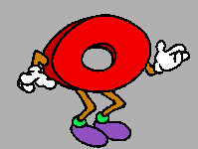
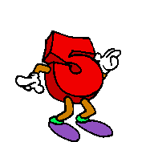
Let’s Learn The 0-12

Slide 2
Let’s Learn The 0-12

Slide 3
zero

Slide 4
one

Slide 5
two

Slide 6
three

Slide 7
four

Slide 8
five

Slide 9
six

Slide 10
seven

Slide 11
eight

Slide 12
nine

Slide 13
ten

Slide 14
eleven

Slide 15
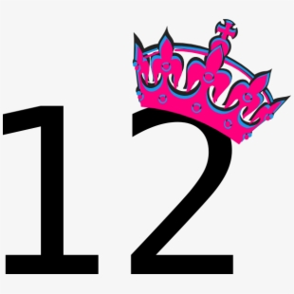
twelve

Slide 16
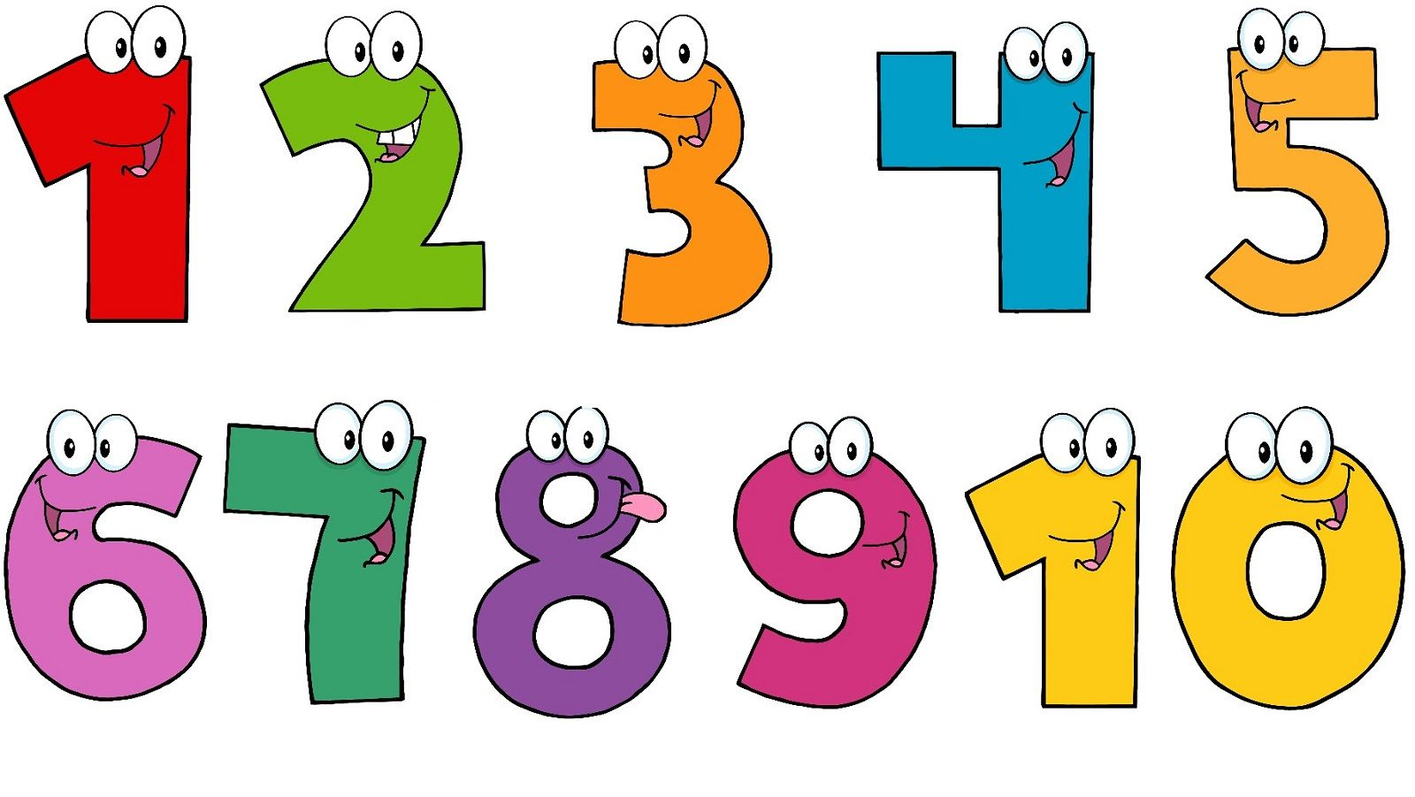
Copy into notebooks انسخوا على دفاتركم
Today is ___________
Numbers
one - 1 seven - 7
two - 2 eight - 8
three -3 nine – 9
four – 4 ten - 10
five – 5 eleven - 11
six – 6 twelve - 12

Slide 17
What’s missing اكتبو الرقم الناقص
1- one, _______, three
2-five, six, _________
3- Three, _________, five
4-ten, ______ twelve
5- seven, _________, nine

Slide 18
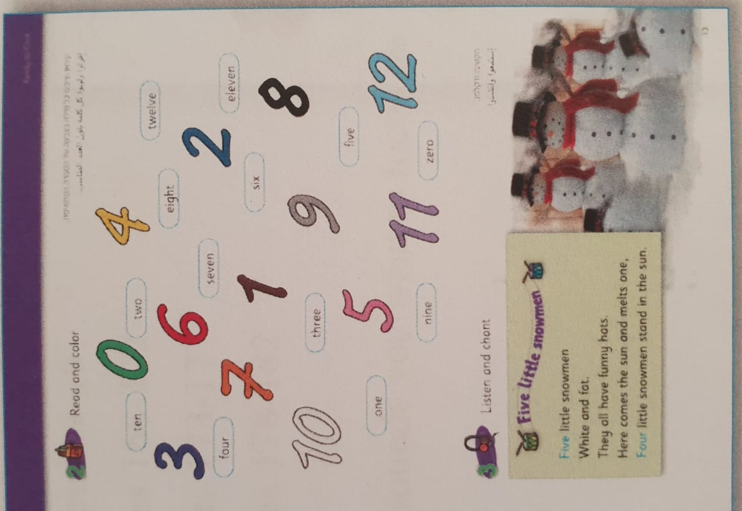
Do the exercise on p.13 حل التمرين في صفحه 13 في الكتاب

