Slide 1
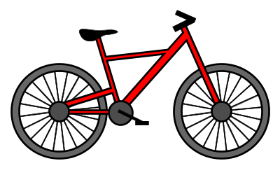
bike

Slide 2
boots

Slide 3
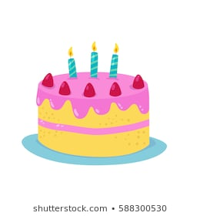
cake

Slide 4
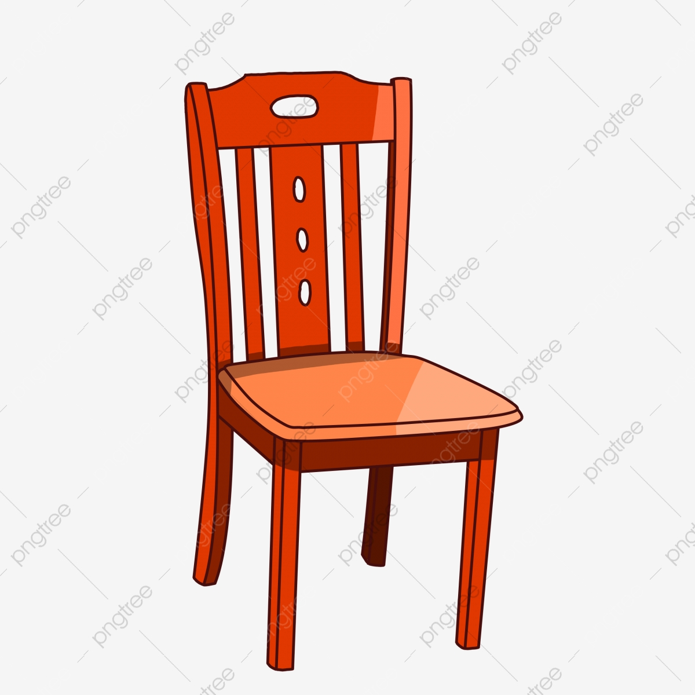
chair

Slide 5
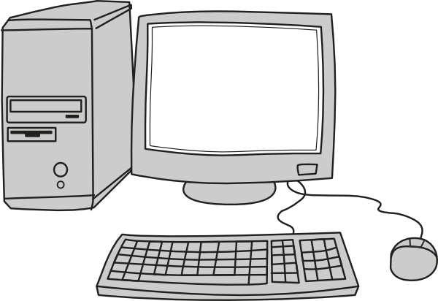
computer

Slide 6
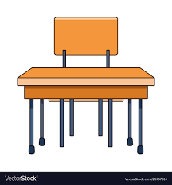
desk

Slide 7
hat

Slide 8
house

Slide 9
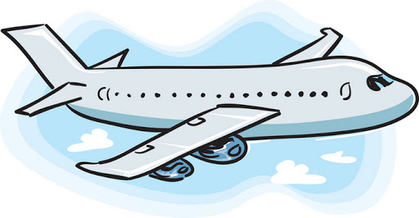
plane

Slide 10
present

Slide 11
school

Slide 12
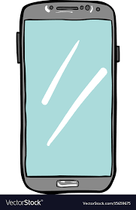
telephone

