Slide 1
Verb to be
الفعل المساعد

Slide 2
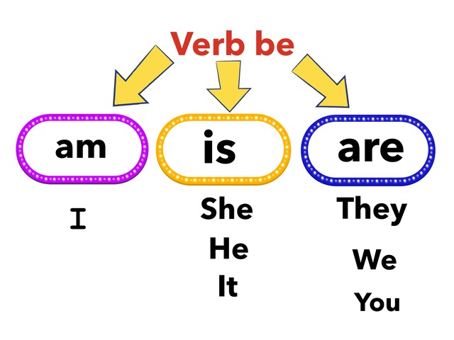

Slide 3
I am happy.
انا سعيد

Slide 4
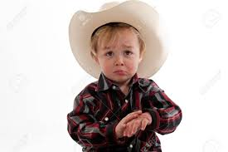
He is sad.
هو حزين

Slide 5
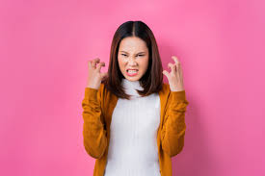
She is mad.
هي غاضبه

Slide 6
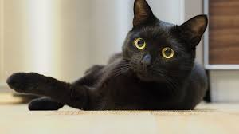
It is black.
انها سوداء

Slide 7
They are happy.
هم سعداء

Slide 8
You are a pupil.
انت طالب

Slide 9
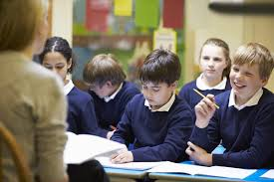
They are pupils.
هم طلاب

Slide 10
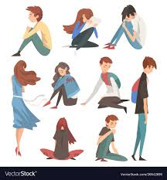
We are sad.
نحن حزينون

Slide 11
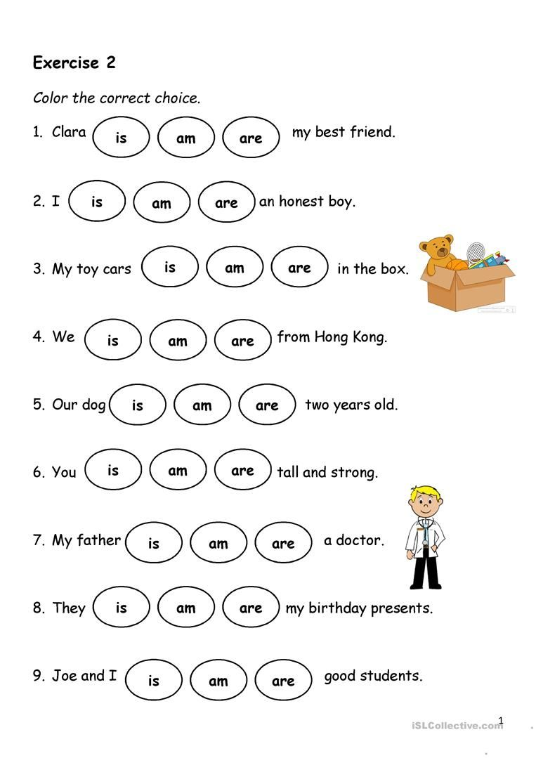
لون الفعل المناسب للجمله

Slide 12
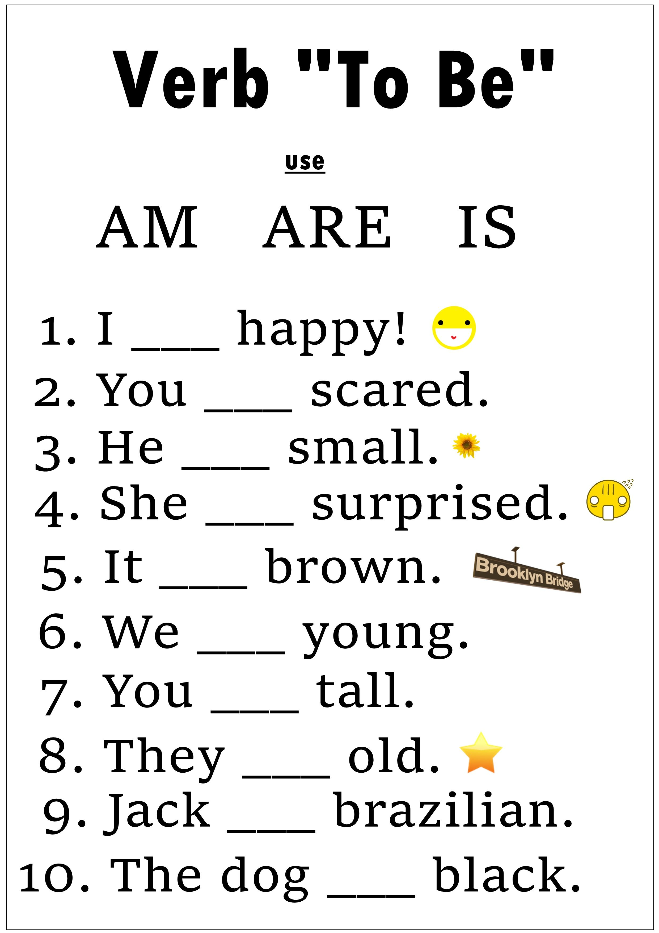
ضع am/ is are

