Slide 1
The colors
The colors

Slide 2
Listen to the colors song
https://www.youtube.com/watch?v=4Ig3CzYIyu4&ab_channel=EnglishTreeTV

Slide 3
blue
The sky is blue.

Slide 4
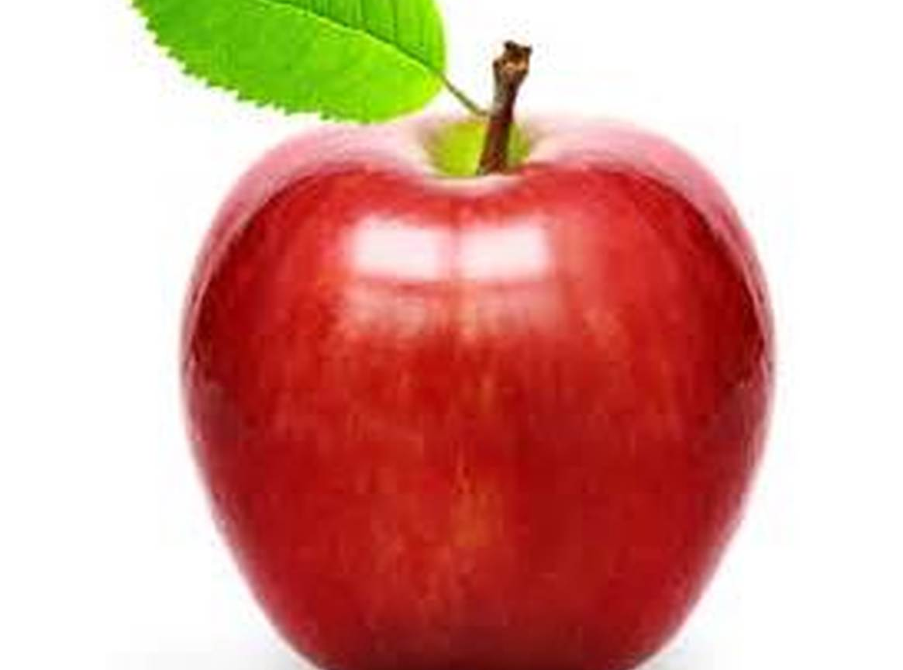
red
The apple is red.

Slide 5
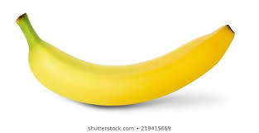
yellow
The banana is yellow.

Slide 6
green
The book is green.

Slide 7
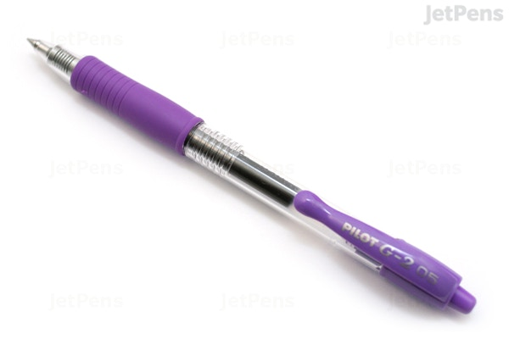
Purple
The pen is purple.

Slide 8
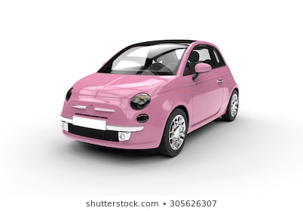
pink
The car is pink.

Slide 9
brown
The pencil is brown.

Slide 10
black
The cat is black.

Slide 11
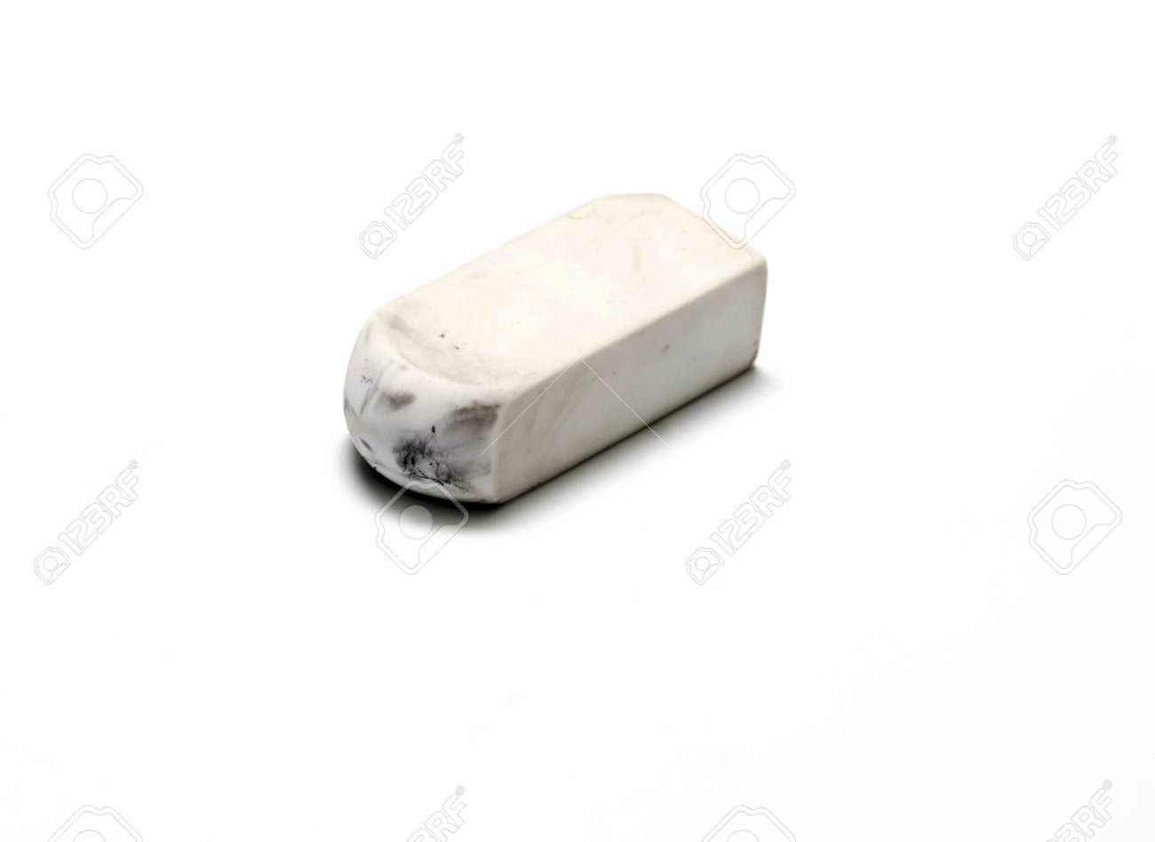
white
The eraser is white.

Slide 12
grey
The notebook is grey.

Slide 13
Game time
https://www.eslgamesplus.com/colors-vocabulary-esl-memory-game/

Slide 14
worksheet

Slide 15
Live worksheet
https://www.liveworksheets.com/worksheets/en/English_as_a_Second_Language_(ESL)/Colours/Color_Wordsearch_pk68097xi

